Slide 1
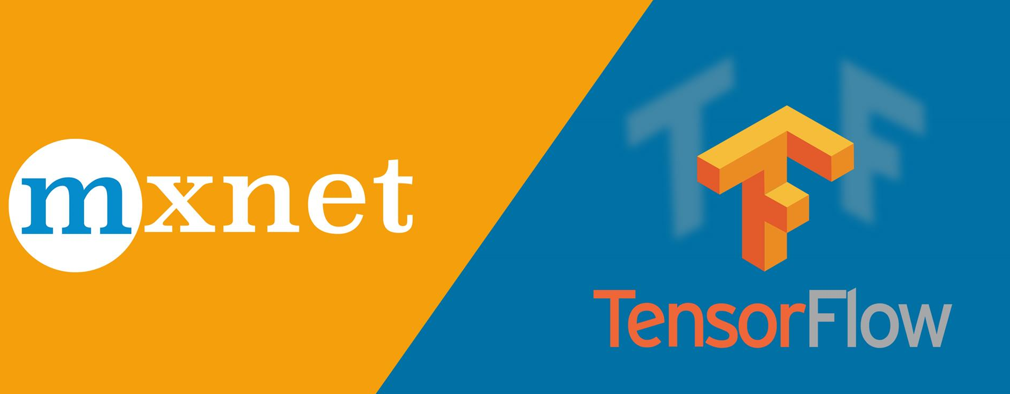
MXNet Vs Tensorflow
Reza Marzban

Slide 2
Tensorflow
A free, Open-Source library by Google.
Version 1 was released on Feb 11th 2017.
It can run on multiple CPUs, GPUs and TPUs.
Computations are expressed as dataflow graphs.
Tensors are multidimensional data arrays

Slide 3
How does it work?
Dataflow graphs are structures that describe how data moves through a graph.
Each node in graph is a mathematical operation.
Each connection or edge between nodes is a multidimensional data array (Tensor)
The users write programs in python, The actual math operations, however, are not performed in Python. The libraries of transformations that are available through TensorFlow are written as high-performance C++ binaries.

Slide 4
MXNet
An open-source deep learning platform by Apache
It’s first release was in 2017.
It is portable and can scale to multiple GPUs.
Models can be trained on powerful machines and used on weaker ones (IOT).
It supports cloud infrastructure.
It is supported by Amazon Web Service and Microsoft Azure.

Slide 5
How does it work?
MXNet supports both imperative and symbolic programming, which makes it easier for developers that are used to imperative programming to get started with deep learning. (similarly to Keras)
The platform supports Python, Scala, Java, Clojure, R, Julia, Perl, C++.
However, only Python and R is implemented for windows.

Slide 6
Comparison of performance
Evaluation of both platforms on Mnist Handwritten digit database with the same Neural network structure (4 Fully Connected Layers):
Source: https://medium.com/@mouryarishik/tensorflow-2-0-vs-mxnet-41edd3b7574f
Platform | Test Accuracy | Training Time (Seconds)
Tensorflow | 97.42 % | 21.5
MXNet-Gluon | 98.07 % | 14
MXNet | 98.08 % | 8.14

Slide 7
Comparison of performance
Evaluation of both platforms on Mnist Handwritten digit database with the same Neural network structure (Lenet Structure):
Source: https://medium.com/@mouryarishik/tensorflow-2-0-vs-mxnet-41edd3b7574f
Platform | Test Accuracy | Training Time (Seconds)
Tensorflow | 98.01 % | 45.9
MXNet-Gluon | 98.97 % | 24.7
MXNet | 98.94 % | 18.6

Slide 8
Conclusion
There are many other examples available, They all unanimously agree on that MXNet is faster than Tensorflow, but we can not conclude on its better accuracy.
Tensorflow is mostly used for research and academic purposes, and MXNet used for industrial and production proposes.

